Slide 1
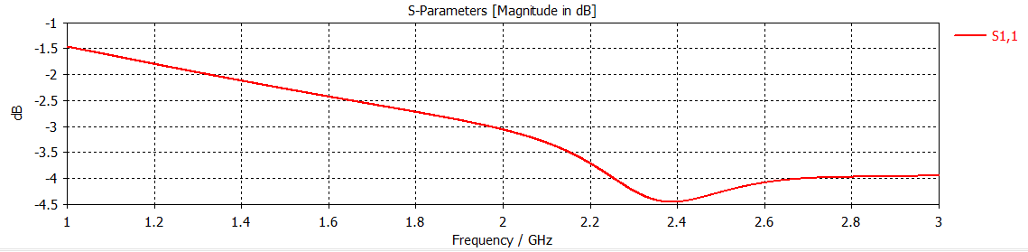
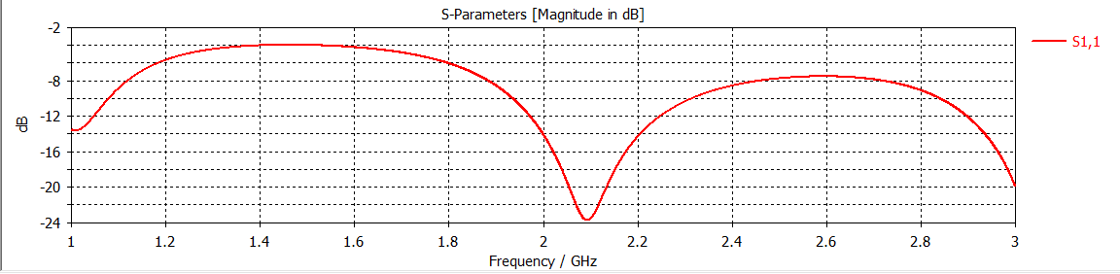
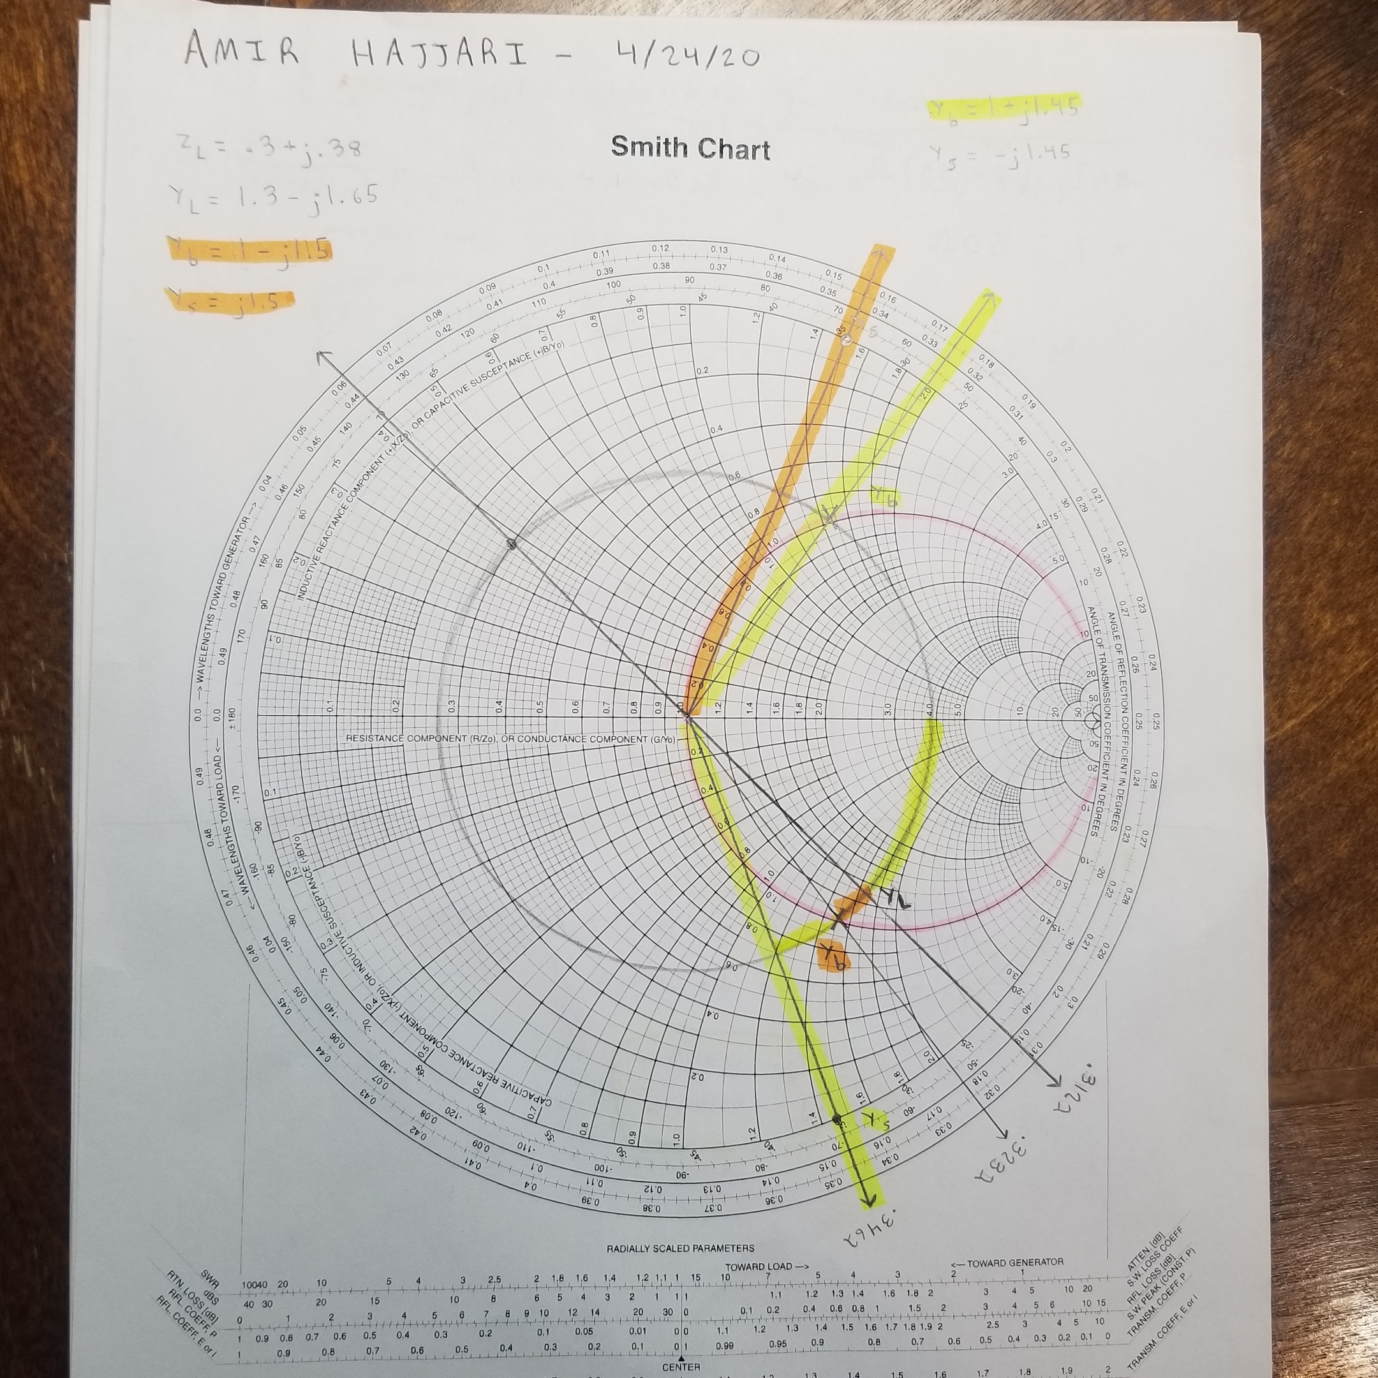
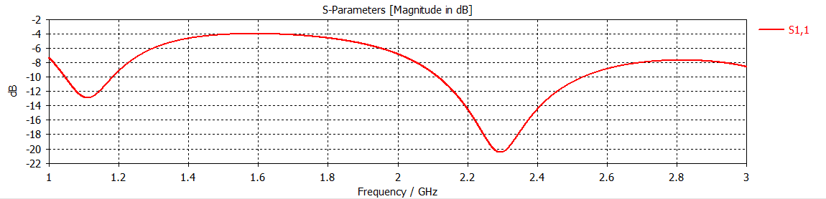
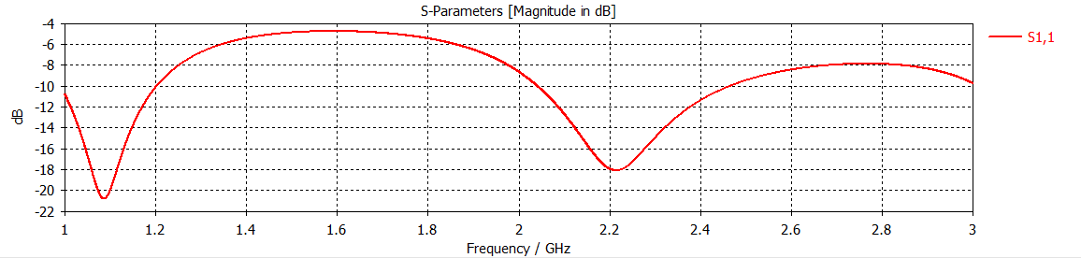
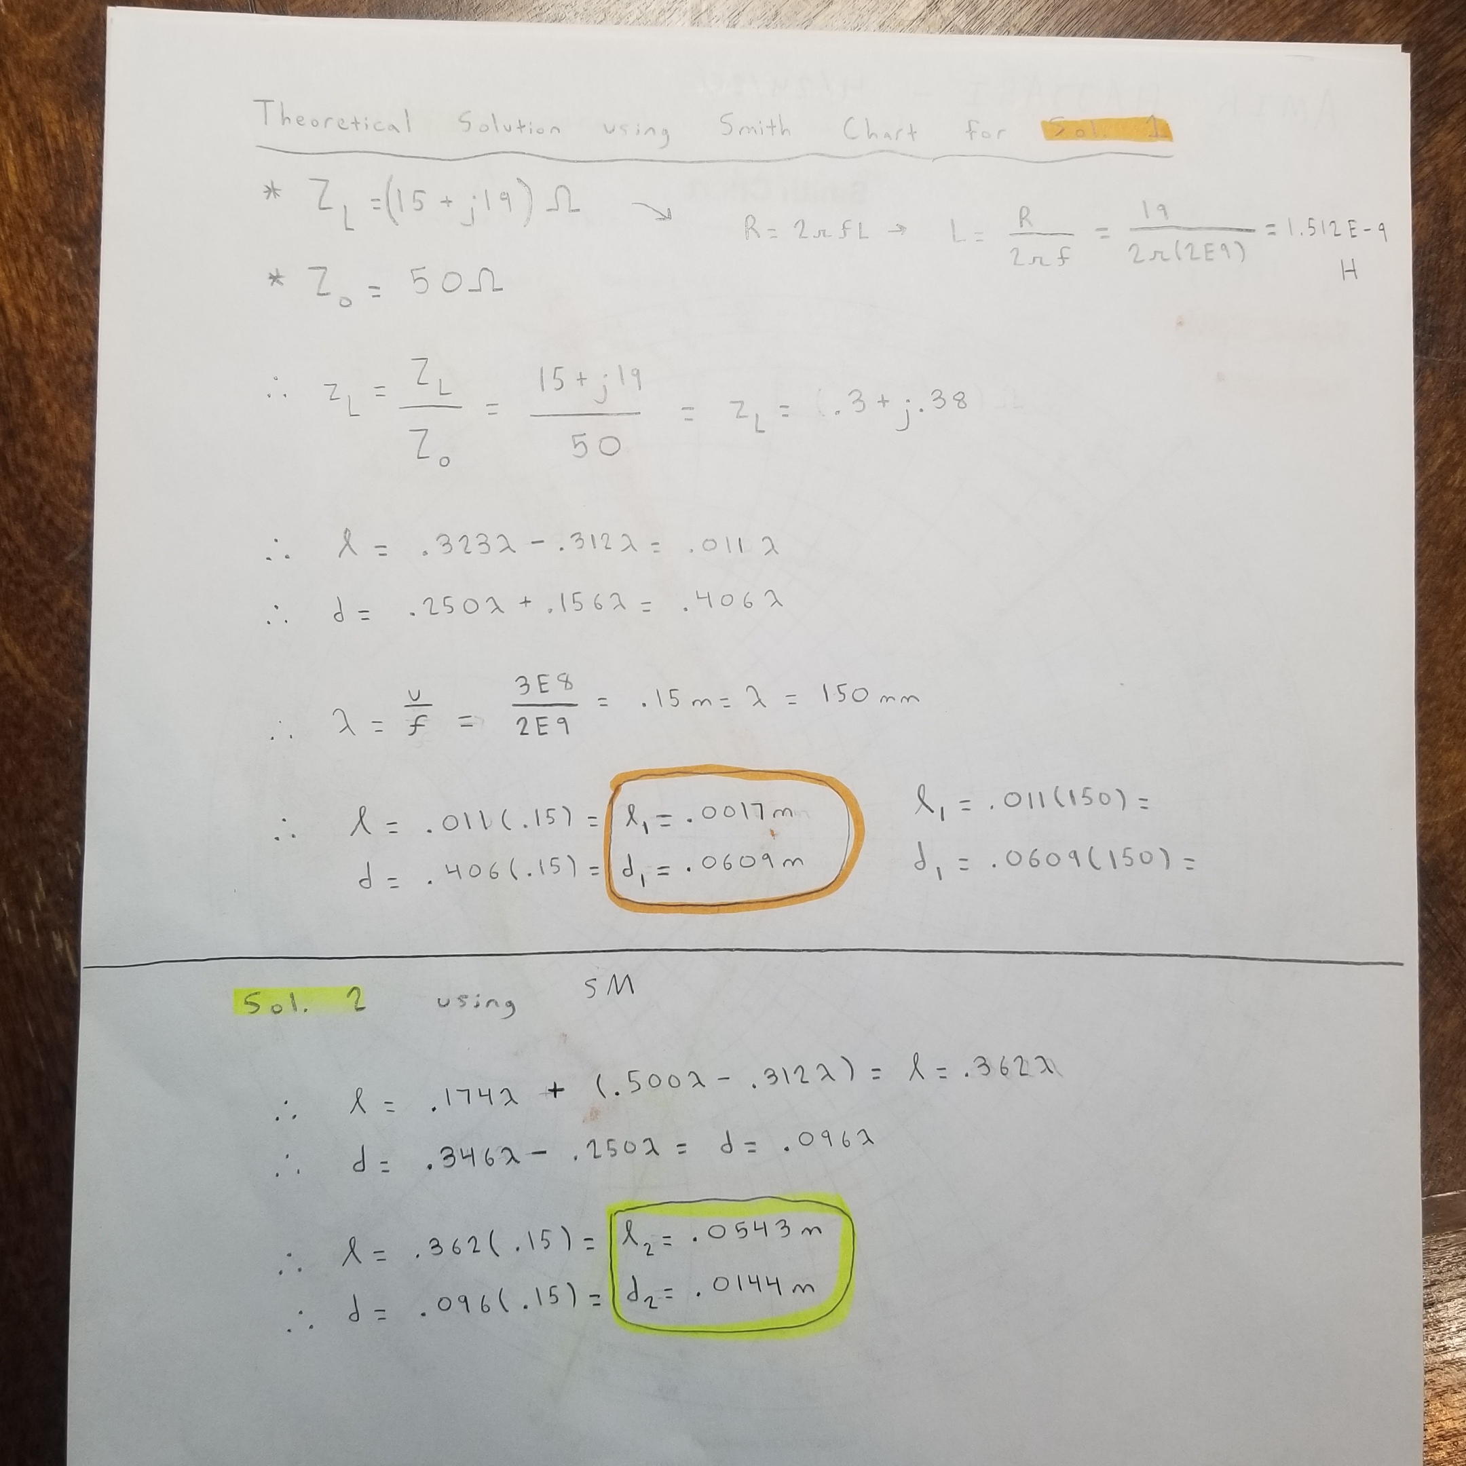
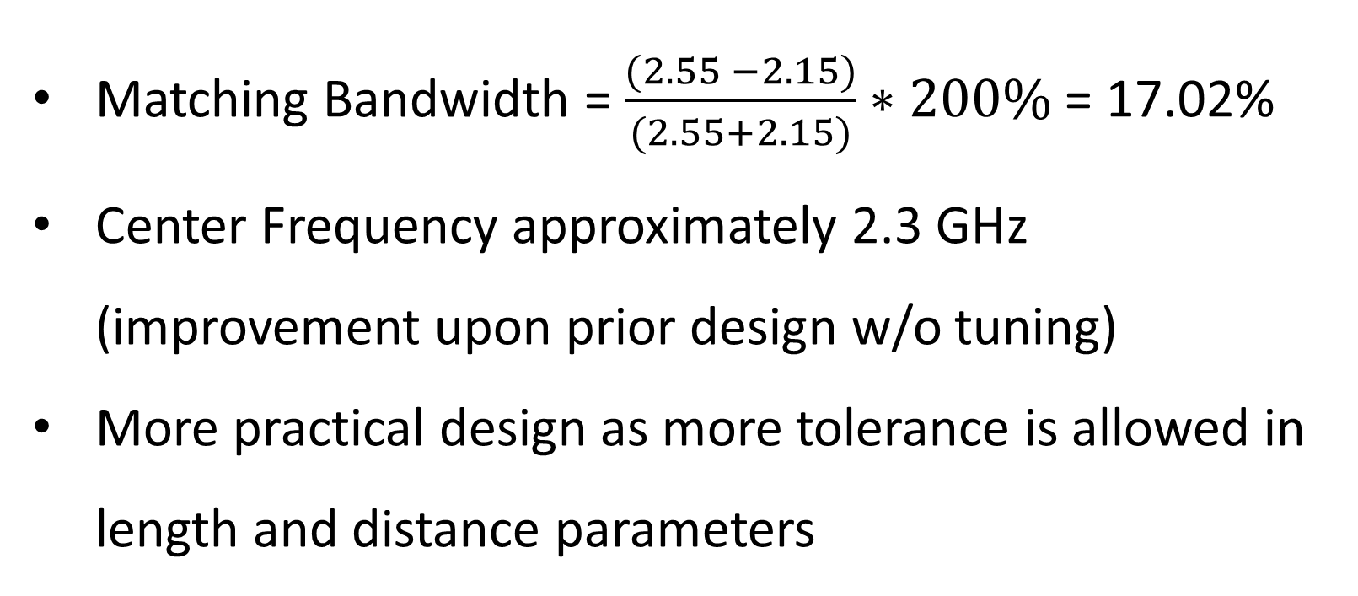
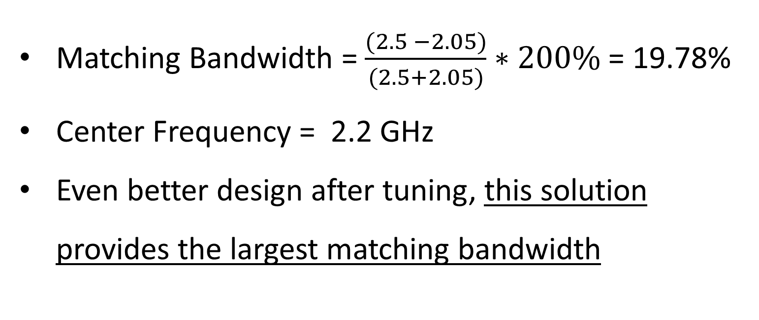
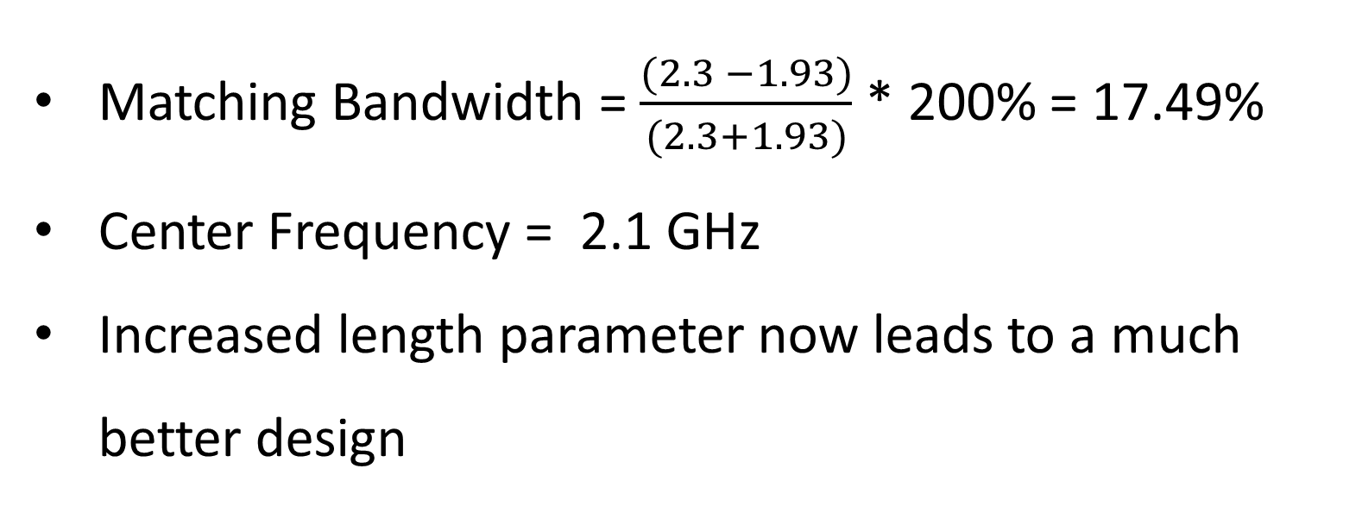
Theoretical and Simulated Solutions to a Short-Stub Transmission Line Problem
Amir Hajjari, ECE 302 Final Project, Created on 4-24-20
Details of Line
Load: (15 + j19) Ω
Characteristic Impedance of Line: 50 Ω
Ideal Operating Frequency: 2 GHz
CST Simulations and Results (Before Tuning)
CST Simulations and Results (After Tuning)
Solution 1
Solution 1
Smith Chart Solutions
Matching Bandwidth = 0
Center Frequency approximately 2.4 GHz
Extremely small length parameter is the reason for this seemingly poor design
Matching Bandwidth = $\frac{(2.3 −1.93)}{(2.3+1.93)}$ * 200% = 17.49%
Center Frequency = 2.1 GHz
Increased length parameter now leads to a much better design
Solution 2
Solution 2
Matching Bandwidth = $\frac{(2.55 −2.15)}{(2.55+2.15)}∗200\%$ = 17.02%
Center Frequency approximately 2.3 GHz (improvement upon prior design w/o tuning)
More practical design as more tolerance is allowed in length and distance parameters
Matching Bandwidth = $\frac{(2.5 −2.05)}{(2.5+2.05)}∗200\%$ = 19.78%
Center Frequency = 2.2 GHz
Even better design after tuning, this solution provides the largest matching bandwidth

